Slide 1
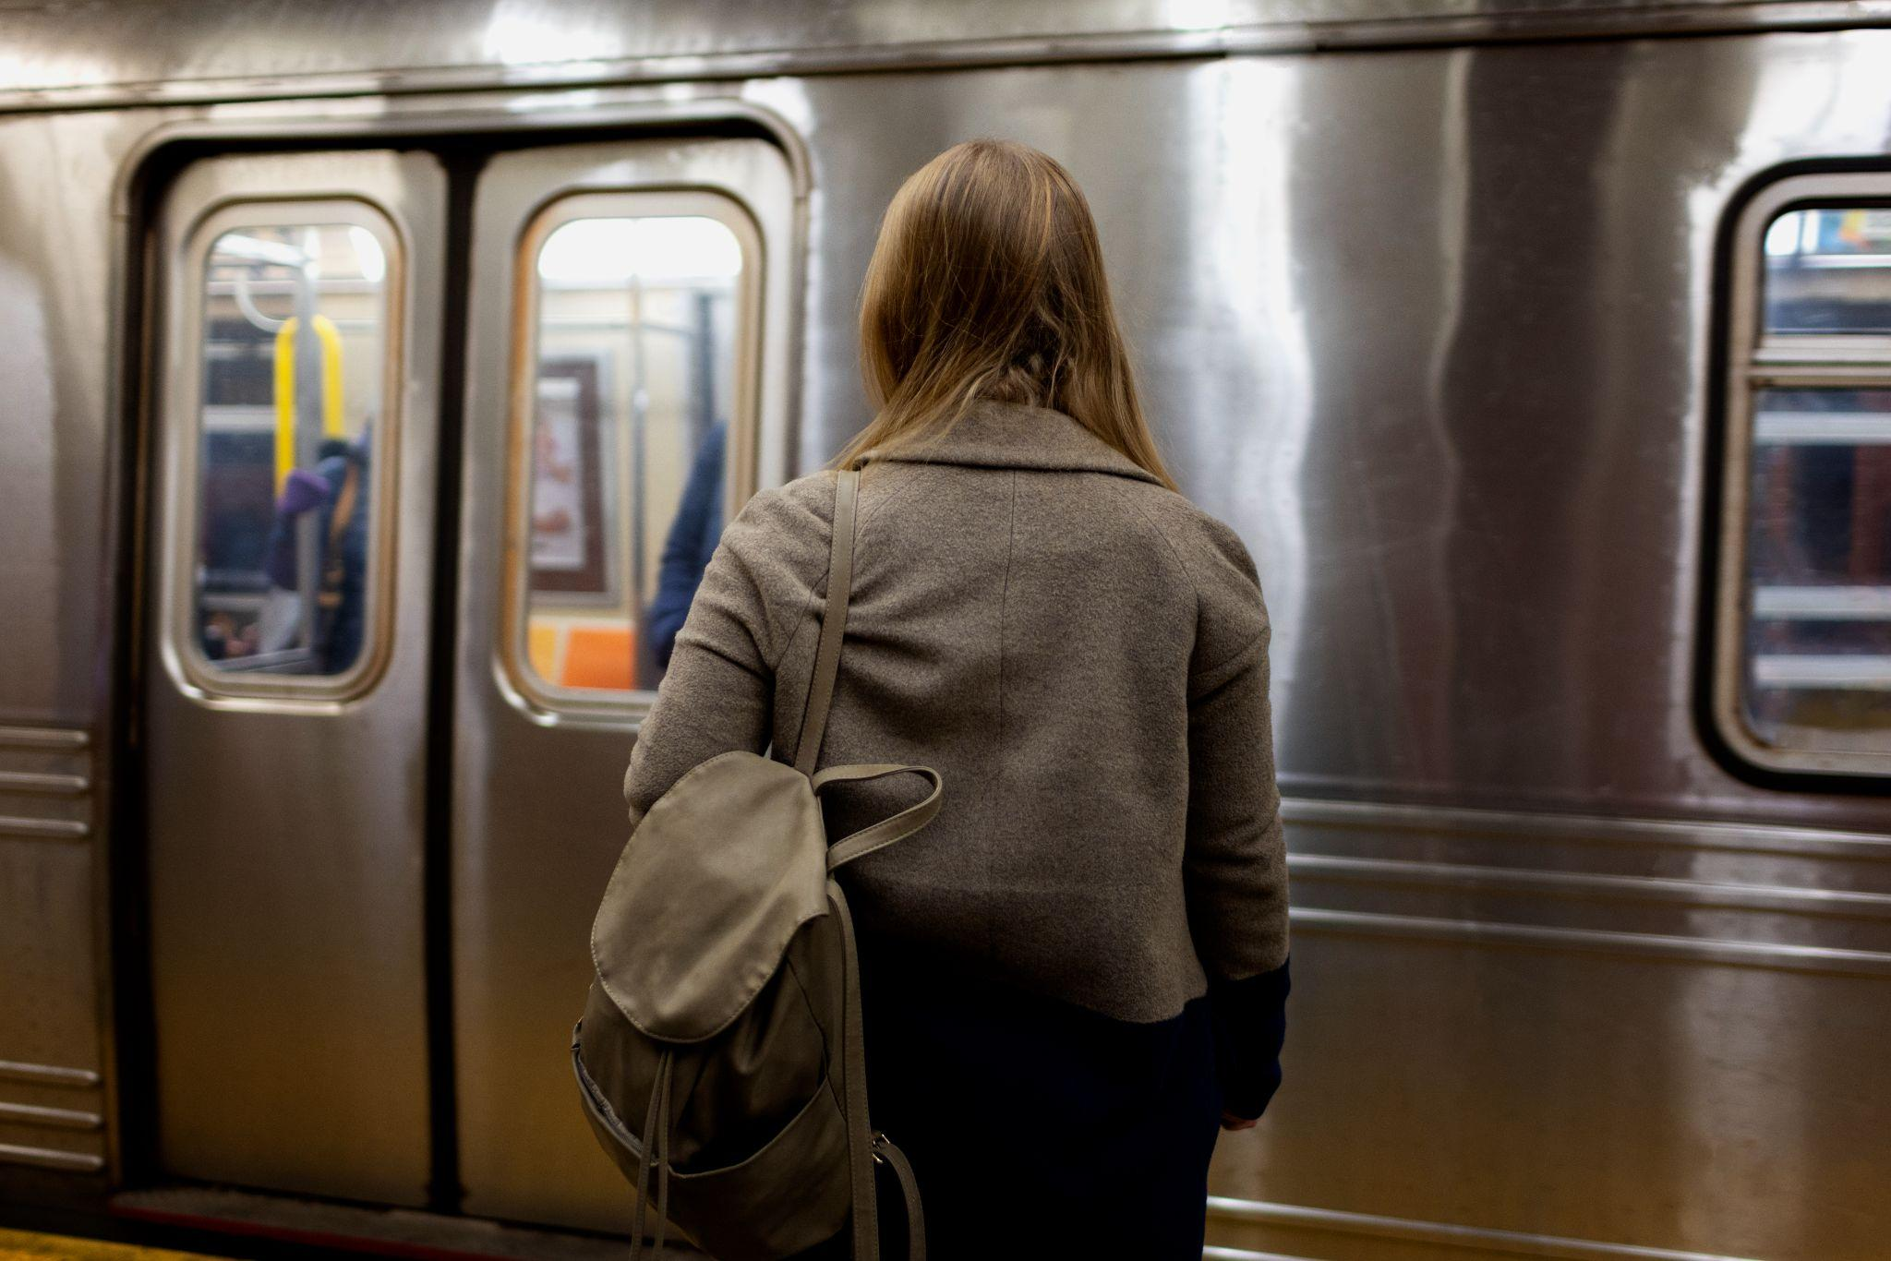

Delhi Metro Connectivity
Project By Anishka Agarwal 1st year Btech CSE
ICP Hackathon 2024

Slide 2
TABLE OF CONTENTS
01
02
03
04
05
Objectives
Delhi Metro ridership data and patterns
Introduction
History and present day facts
Analysis
Visualization using Python and Power BI
Future growth
Future perspectives, theories & predictions based on the given data
Challenges
Day to day challenges faced by DMRC

Slide 3
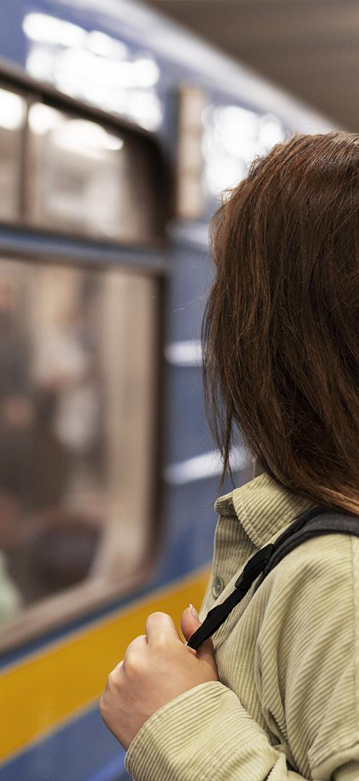
OBJECTIVE
To analyse Delhi metro data for insights into ridership patterns, station usage and productivity.
Tools used: Power BI for data visualization and Python libraries for data processing.
Pandas: for data manipulation
NumPy: for numerical operations
Matplotlib and Seaborn for initial data visualization

Slide 4
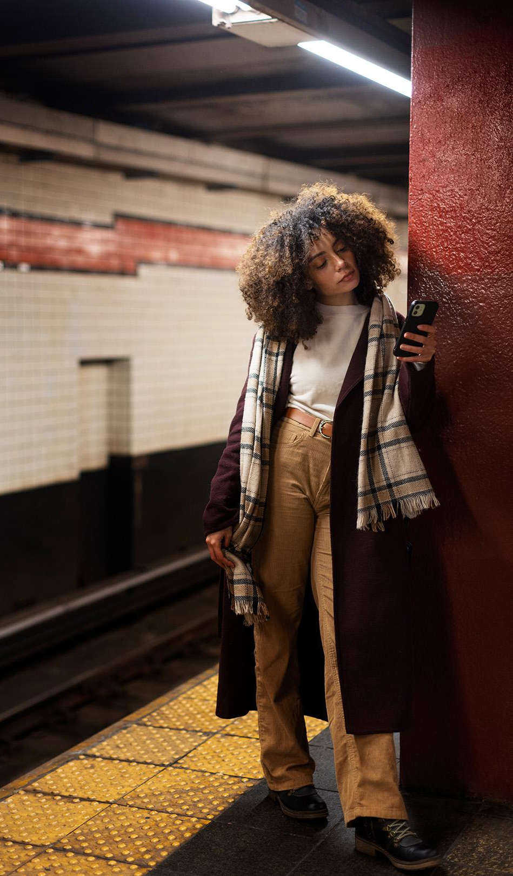
02
INTRODUCTION
DELHI METRO OVERVIEW

Slide 5
For implementation and subsequent operation of Delhi MRTS, a company under the name DELHI METRO RAIL CORPORATION was registered on 03-05-95 under the Companies Act, 1956. It was inaugurated on December 24, 2002 & is managed by DMRC, Delhi. As of 2023, the network spans over 390 kms. There are around 13 Major lines including the Airport express line and 285 stations (underground, at-grade, elevated stations). On average it serves over 2.6 million passengers daily.
Lines and Routes
Red Line: From Rithala to Shaheed Sthal (New Bus Adda).
Yellow Line: From Samaypur Badli to HUDA City Centre.
Blue Line: Consists of two routes - Dwarka Sector 21 to Noida City Centre
Blue Line branch: Yamuna Bank to Vaishali
Green Line: From Inderlok/Kirti Nagar to Brigadier Hoshiyar Singh
Green Line branch: Ashok Park Main station to Kirti Nagar
Violet Line: From Kashmere Gate to Raja Nahar Singh.
Orange Line (Airport Express): From New Delhi to Dwarka Sector 21.
Pink Line: From Majlis Park to Shiv Vihar.
Magenta Line: From Janakpuri West to Botanical Garden.
Grey Line: From Dwarka to Najafgarh.
Aqua Line: From Noida Sector 51 to Greater Noida.
Rapid Metro: connects the commercial areas of Gurgaon with Sikandarpur metro station.

Slide 6
CONSTRUCTING A METRO SYSTEM
Phase 1
Phase 2
Phase 3
Phase 4
Planning & Feasibility studies
Design & Engineering
Finance (budgeting)
Land Acquisition and Utility Shifting
Phase 5
Phase 6
Phase 7
Phase 8
Construction & track laying
Installation of system
Testing & Maintenance
Continuous Improvement

Slide 7
FEATURES
Technology: The metro system uses advanced signaling and telecommunication technology. Most lines are equipped with Communication-Based Train Control (CBTC) for driverless operations.
Facilities: Stations are equipped with escalators, elevators, automatic fare collection systems, and facilities for differently-abled passengers.
Safety and Security: The Delhi Metro has a comprehensive security system including CCTV surveillance, baggage screening, and metal detectors. The CISF (Central Industrial Security Force) handles security.
Sustainability: The Delhi Metro is recognized for its green initiatives, including the use of solar power, regenerative braking in trains, and eco-friendly construction practices. It is the first metro rail and rail-based system in the world to get "carbon credits" for reducing greenhouse gas emissions.

Slide 8
FACTS
Environmental Friendliness: The Delhi Metro is known for its eco-friendly initiatives. It is the first metro system in the world to receive carbon credits from the United Nations for reducing greenhouse gas emissions by over 630,000 tons annually.
Efficiency and Punctuality: The Delhi Metro is renowned for its punctuality and efficiency. It maintains an on-time performance record of over 99%, which is one of the best in the world.
Women's Coaches: To ensure the safety and comfort of female passengers, the Delhi Metro has dedicated coaches for women in every train.
Driverless Technology: The Delhi Metro introduced driverless train operations on the Magenta Line in 2020, incorporating advanced technology and automation for safer and more efficient service.
Innovative Ticketing: The Delhi Metro uses a contactless smart card system for fare collection, which can also be linked to bank accounts.
Green Stations: Several metro stations are designed to be eco-friendly, incorporating solar panels, rainwater harvesting systems, and energy-efficient technologies.

Slide 9
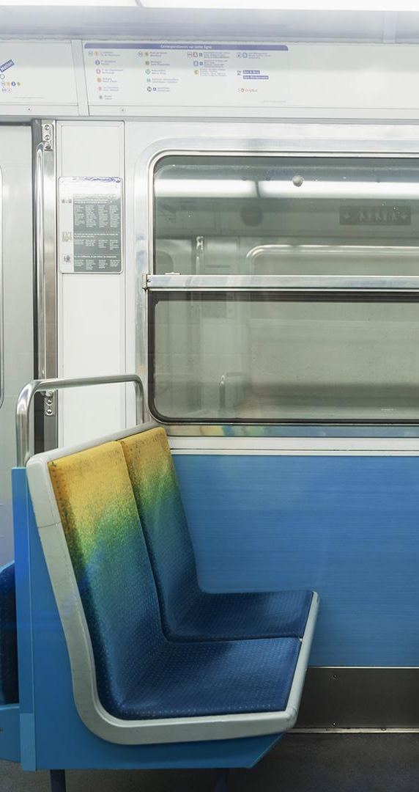
ANALYSIS
03
Delhi Metro Network

Slide 10
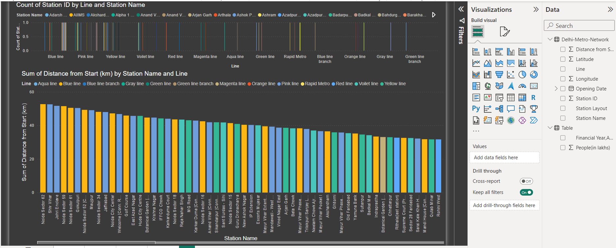

Data analysis (PowerBI)
Click here for full report

Slide 11
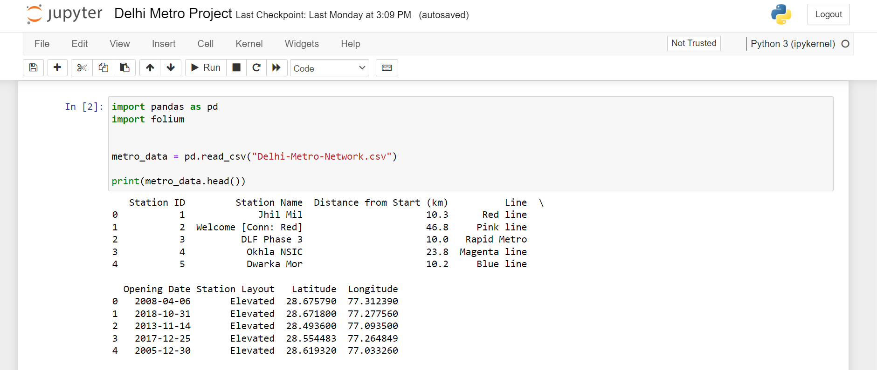
Data analysis (Python)
Click here for full report

Slide 12
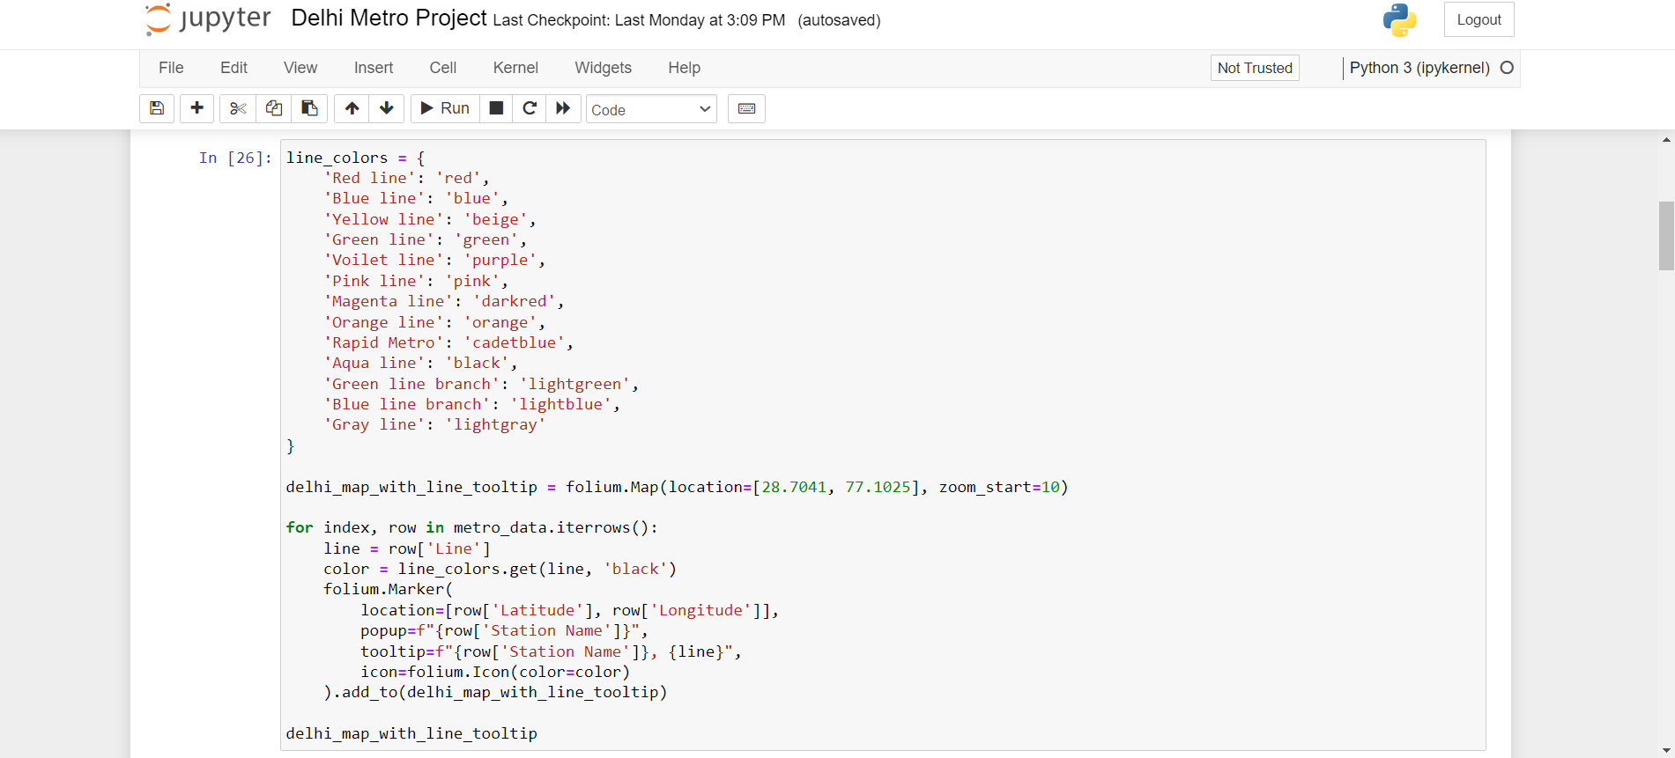

Slide 13
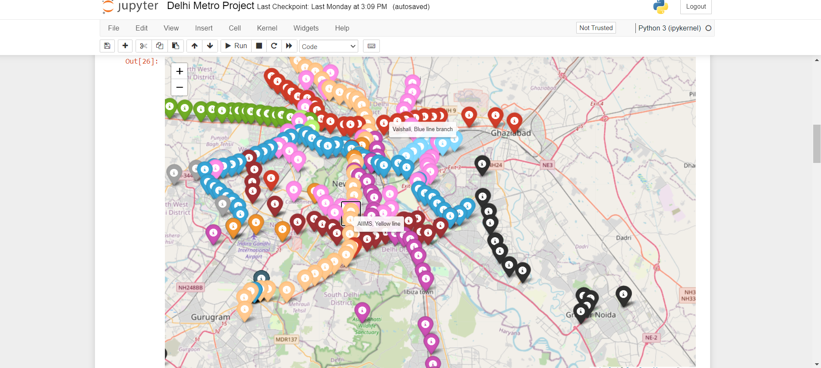

Slide 14


Slide 15
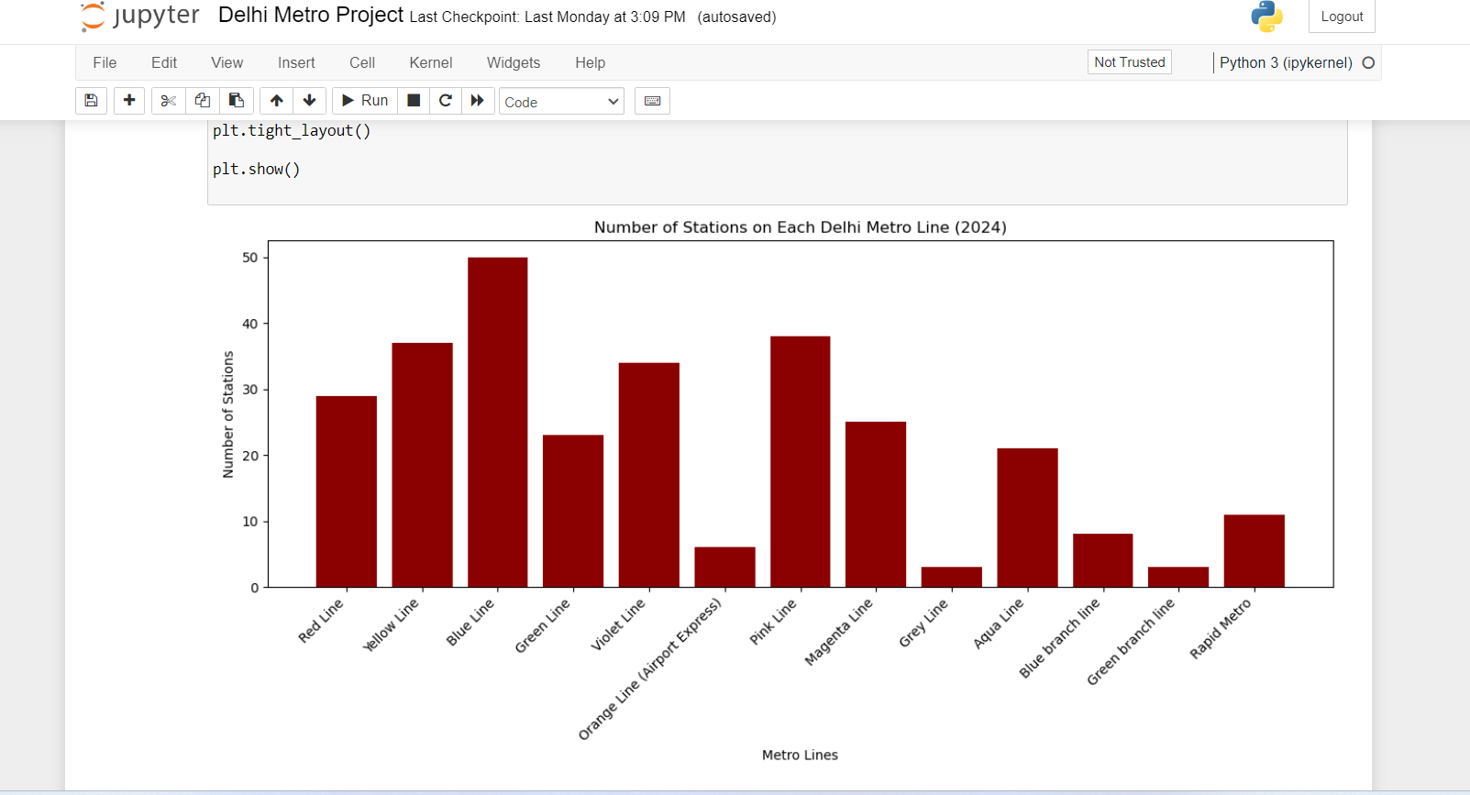

Slide 16
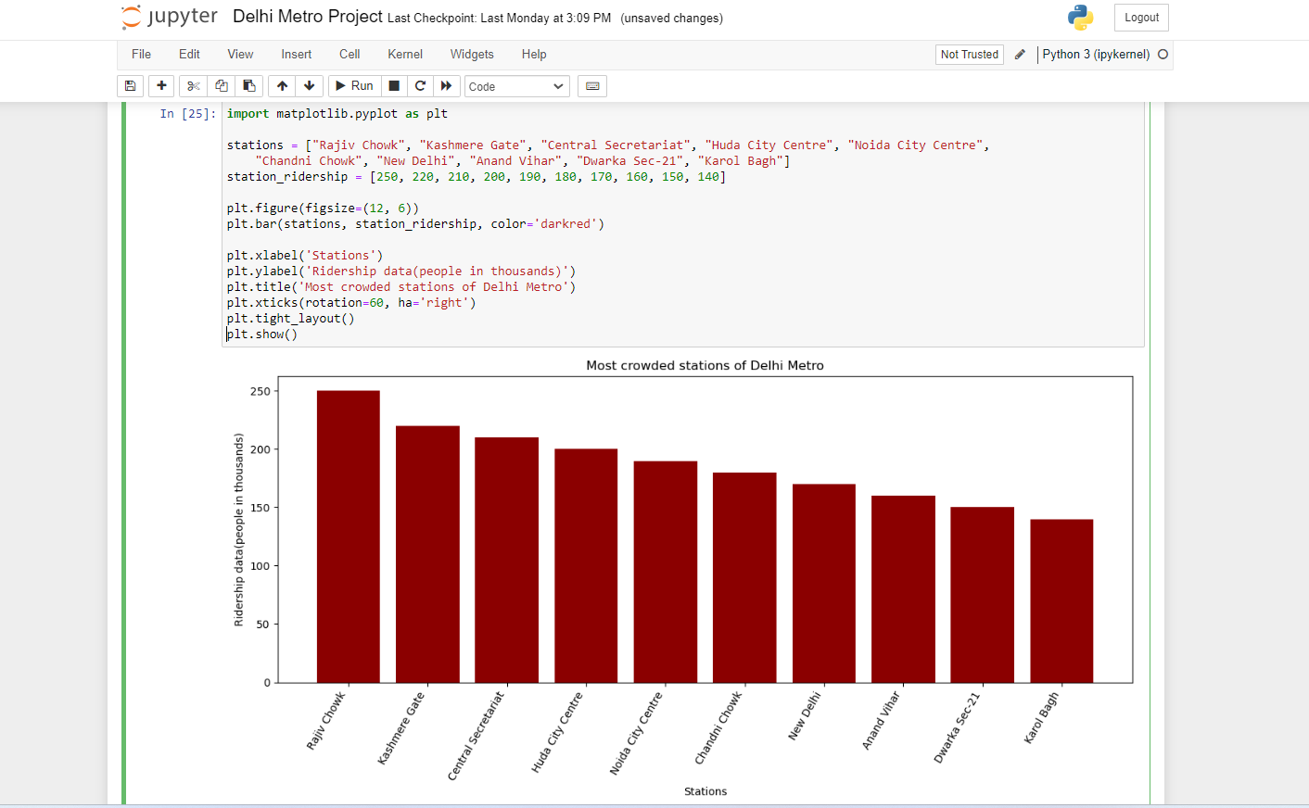

Slide 17
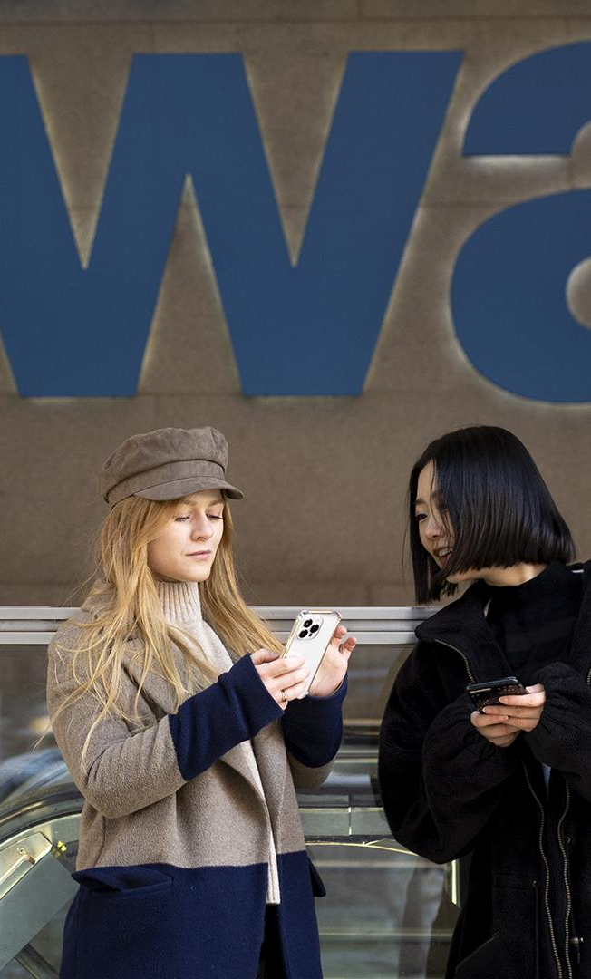
04
FUTURE OF DELHI METRO

Slide 18
Technological advancements & Strategic expansion
The future of the Delhi Metro looks promising, with several plans and projects aimed at expanding and enhancing the system.
Network Expansion: The upcoming Phase IV, which includes new lines and extensions of existing ones, is expected to add around 104 kilometers to the network. This phase will improve connectivity to various parts of the National Capital Region (NCR).
Advanced Technology and Automation: The Delhi Metro is set to adopt more advanced technologies, including driverless train operations on additional lines. The use of AI and IoT for better monitoring and maintenance is also in the pipeline. The Delhi Metro is looking to enhance its smart card system and mobile applications as well.
Transit-Oriented Development (TOD): promoting Transit-Oriented Development around its stations. This involves creating mixed-use developments that include residential, commercial, and recreational facilities within walking distance of metro stations, encouraging more people to use public transportation.
Innovative Financing Models: To support its expansion and modernization plans, the Delhi Metro is exploring innovative financing models, including issuing green bonds and securing international funding.

Slide 19
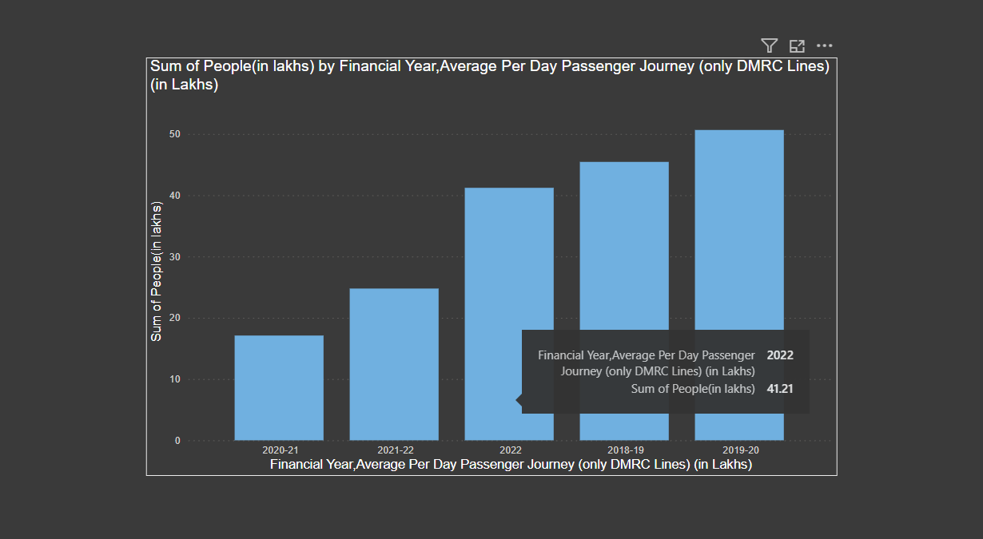

Slide 20
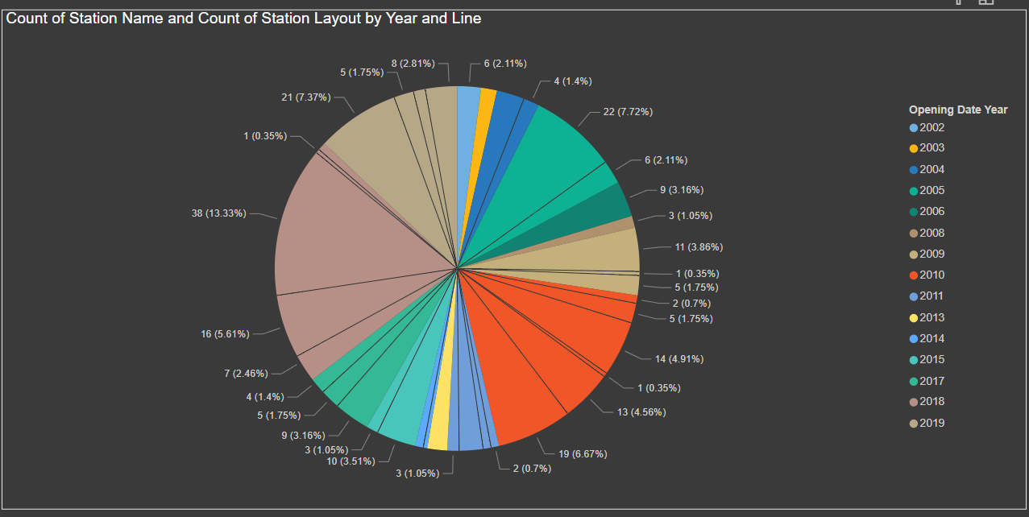

Slide 21
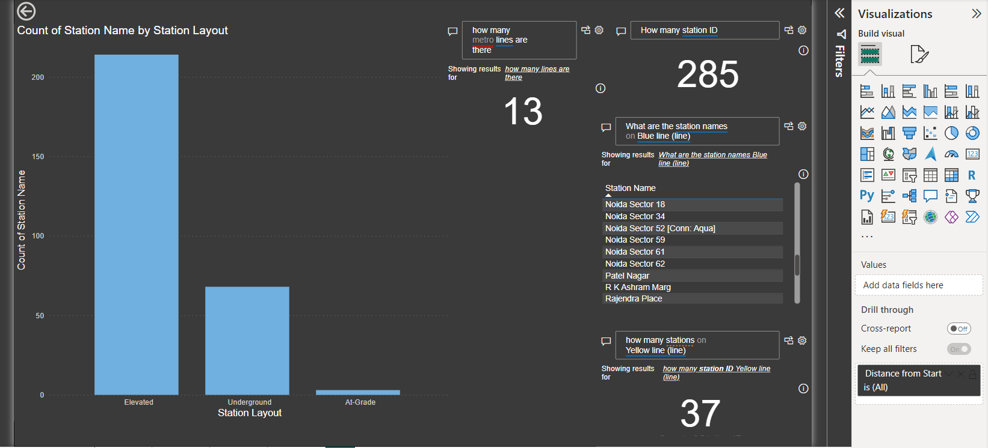

Slide 22
05
CHALLENGES FACED

Slide 23
Construction Challenges: Building metro lines, especially in densely populated and congested urban areas, presents significant engineering and logistical challenges. Ensuring minimal disruption to daily life and initiating eco friendly environment is important.
Maintenance: As the network expands, maintaining operational efficiency becomes more complex. This includes ensuring timely train services, minimizing technical glitches, and managing the increasing number of passengers effectively. Any disruptions can have a cascading effect on the entire system.
Safety and Security: Ensuring the safety and security of passengers is a continuous challenge. The metro system needs to be vigilant against potential threats, including terrorism and vandalism, and must implement robust security measures, which can be resource-intensive.
Accessibility: Despite efforts to improve accessibility, there are still areas where infrastructure needs to be upgraded to meet the needs of all passengers.
Public Awareness and Behavior: Educating the public about using the metro responsibly and maintaining decorum can be challenging. Issues such as overcrowding, cleanliness, and adherence to metro rules require continuous public awareness campaigns and enforcement measures.

Slide 24
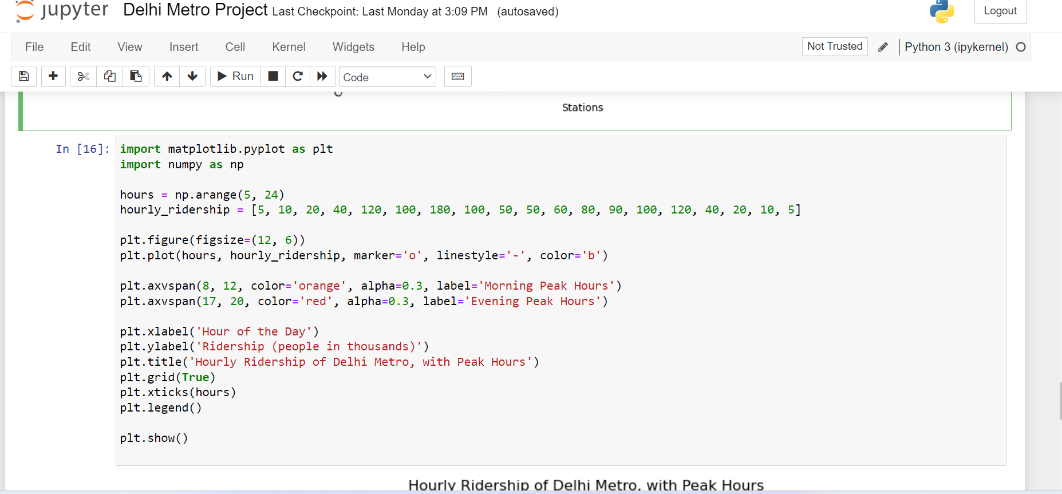

Slide 25
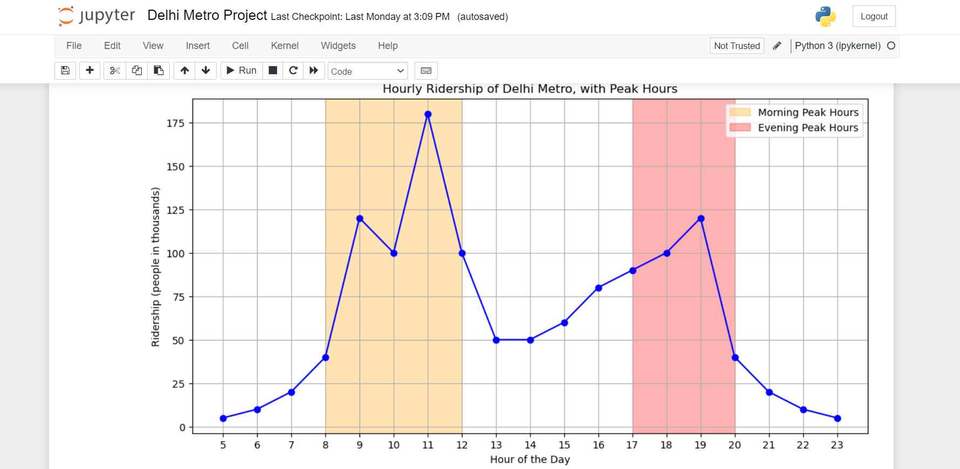

Slide 26
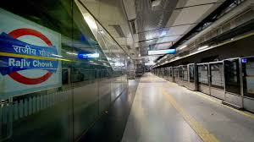
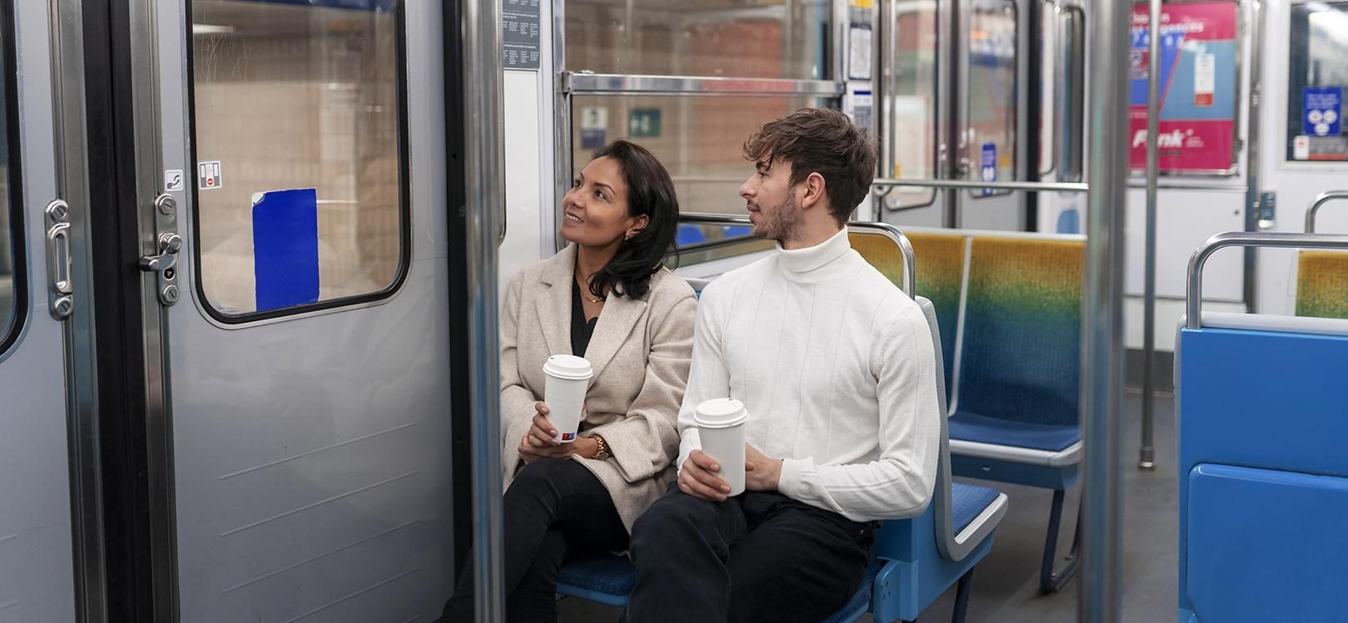
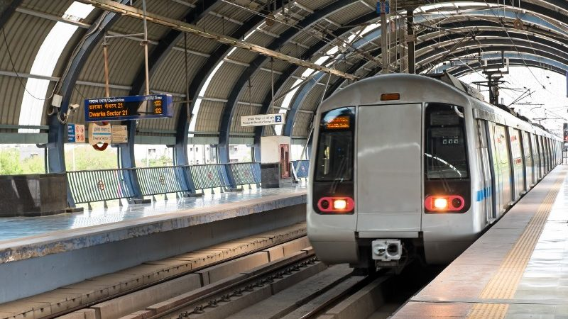
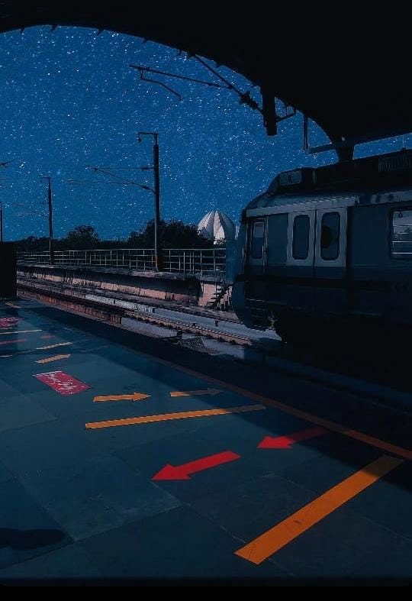
Pictures

Slide 27
THANK YOU
anishka_agarwalb
https://www.linkedin.com/in/anishka-agarwal-8a11b9279?utm_source=share&utm_campaign=share_via&utm_content=profile&utm_medium=android_app

